Slide 1
SSH-SFTP

Slide 2
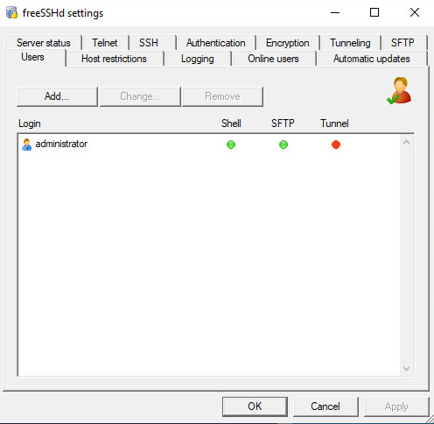
FreeSSH
Download ứng dụng freeSSH
http://www.freesshd.com/?ctt=download
Copy vào máy chủ DC và cài. A service named “FreeSSHDService” is created.
Start FreeSSH
Add users and configure access level on FreeSSH settings. Restart the FreeSSHDService.

Slide 3
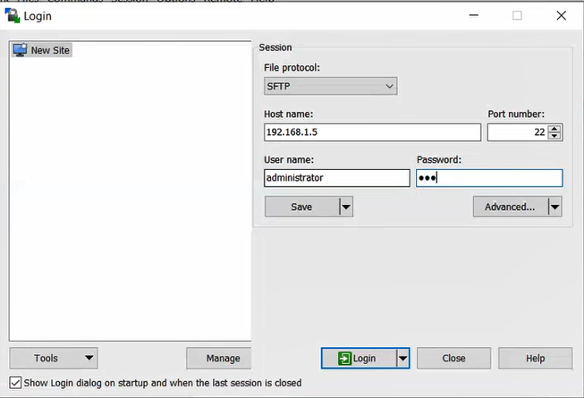
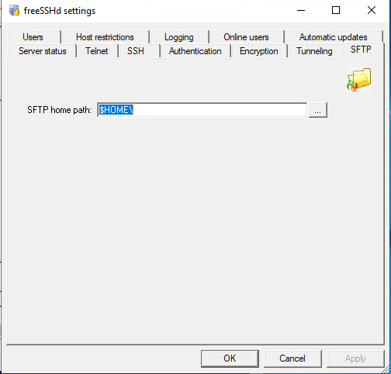
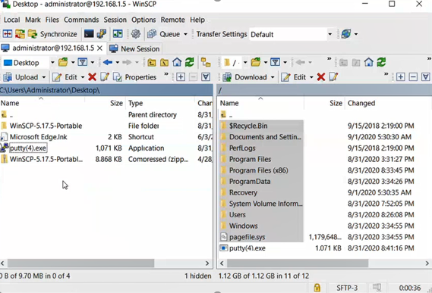
SFTP
Install WinSCP on a client PC.
Specify the home folder.

